Slide 1
Practice of Python Programming

Slide 2
Enter a password
Enter a correct password for less than 5 times

Slide 3
For loop
success = False
for i in range(1,6):
pwd = input("Enter your password: ")
if pwd.upper() == "SF2026":
success = True
print ("Congratulations and you can proceed further")
break
if not success:
print("Your pwd is incorrect. You cannot enter any more")
print ("Wait for 5 mins and you can enter again!")

Slide 4
While loop
success = False
pwd = input("Enter your password: ")
while (pwd.upper() != "SF2026"):
pwd = input("Enter your password: ")
if pwd.upper() == "SF2026":
print ("Congratulations and you can proceed further")
success = True
break
if not success:
print("Your pwd is incorrect. You cannot enter any more")
print ("Wait for 5 mins and you can enter again!")

Slide 5
While loop + <= 5 times
max_times = 5
Target = "SF2026"
pwd = input("Enter your password: ")
success = False
count = 1
while ((pwd.upper() != "SF2026") & (count < 5)):
count = count + 1
pwd = input("Enter your password: ")
if pwd.upper() == "SF2026":
print ("Congratulations and you can proceed further")
success = True
break
if not success:
print("you have entered: ", count, "times and your pwd is incorrect. You cannot enter any more")
print ("Wait for 5 mins and you can enter again!")

Slide 6


Quadratic equation

Slide 7
Code
import math
a = float(input("a=: "))
b = float(input("b=: "))
c = float(input("c=: "))
while (a == 0):
print ("a cannot be zero!")
a = float(input("a=: "))
while (b*b-4*a*c)<0:
print ("b2-4ac cannot be <=0")
b = float(input("b=: "))
c = float(input("c=: "))
print (a, b, c, "a, b, and c are input correctly!")
x1 = (-b+math.sqrt(b*b-4*a*c))/(2*a)
x2 = (-b-math.sqrt(b*b-4*a*c))/(2*a)
print ("x1 = ", x1)
print ("x2 = ", x2)

Slide 8
Ensure an input of a float
import math
def prompt_float(prompt):
while True:
try:
return float(input(prompt))
except ValueError:
print("Please enter a valid number.")
a = prompt_float("a=: ")
b = prompt_float("b=: ")
c = prompt_float("c=: ")
while (a == 0):
print ("a cannot be zero!")
a = prompt_float("a=: ")
while (b*b-4*a*c)<0:
print ("b2-4ac cannot be <=0")
b = prompt_float("b=: ")
c = prompt_float("c=: ")
print (a, b, c, "a, b, and c are input correctly!")
x1 = (-b+math.sqrt(b*b-4*a*c))/(2*a)
x2 = (-b-math.sqrt(b*b-4*a*c))/(2*a)
print ("x1 = ", x1)
print ("x2 = ", x2)

Slide 9
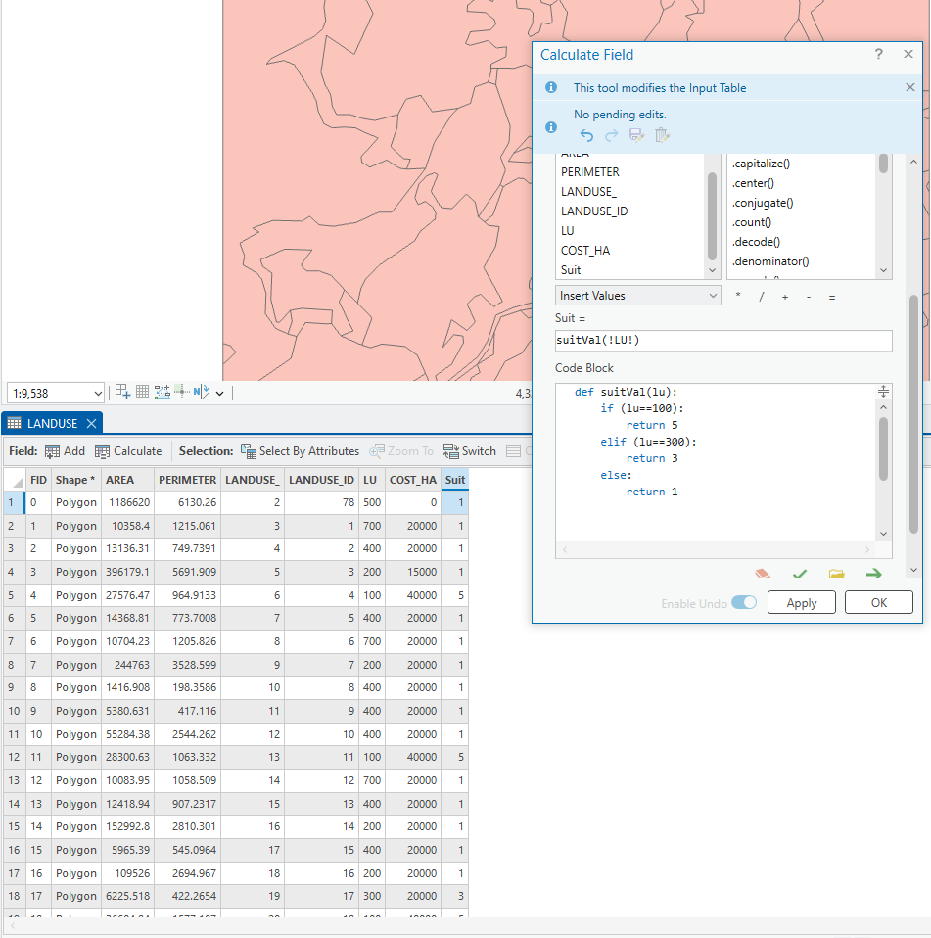

Slide 10
Reverse a list
suits = ['Spades', 'Clubs', 'Diamonds', 'Hearts']
length = len(suits)
#suitsReverse = [None]*length
suitsReverse = suits[::]
print (suitsReverse)
for i in range (0, length):
suitsReverse[i] = suits[length-i-1]
print ("The original list is:", suits)
print ("The reversed list is: ", suitsReverse)

Slide 11
Define a class
class Student:
def __init__(self, name, sid, major):
self.name = name
self.sid = sid
self.major = major
def introduce(self):
print(f"My name is {self.name}. I study {self.major}.")
def change_major(self, new_major):
self.major = new_major
print(f"{self.name} changed major to {self.major}.")
``

Slide 12
Use the class
# Create objects (instances of the class)
s1 = Student("Alice", 12345, "Computer Science")
s2 = Student("Bob", 67890, "Geography")
# Call methods
s1.introduce()
s2.introduce()
# Modify object attributes
s1.change_major("Mathematics")
s1.introduce()

